Slide 1
Data Science Basics in R:
Day 2: Data management

Slide 2
Goals for today
Understand what data management is
Identify some interesting sources of healthcare and public health data (if you don’t already have your own)
Load and clean your first dataset in R
Learn about and implement best practices for:
documenting your code
data dictionaries
Doing reproducible research in R

Slide 3
What is data management

Slide 4
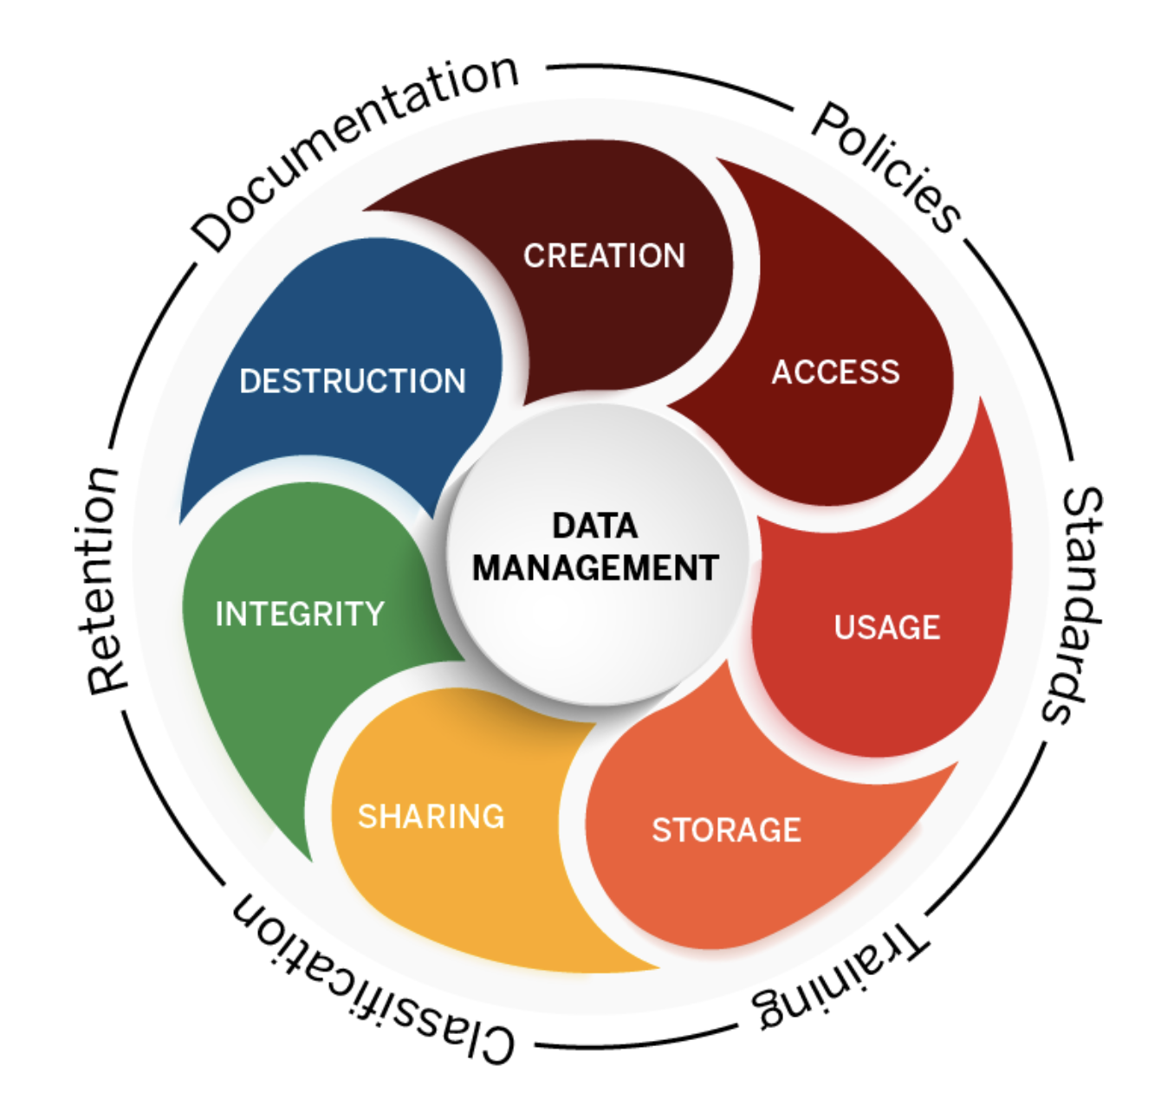
Data management
Notes:
Graphic from https://datamanagement.iu.edu/

Slide 5
Data types and structures in R

Slide 6
Data types in R

Slide 7
Numeric Data

Slide 8
Character Data

Slide 9
Logical Data

Slide 10
Check your understanding

Slide 11
Data Structures in R

Slide 12
Vectors

Slide 13
Data Frames

Slide 14
Reading in a new dataset

Slide 15
Loading data

Slide 16
Data cleaning

Slide 17
Data cleaning

Slide 18
View your dataset in RStudio

Slide 19
Check for missing values

Slide 20
Ask questions about your data

Slide 21
Healthcare and public health datasets

Slide 22
Interesting and useful datasets

Slide 23
Documenting your data, code, and results

Slide 24
Documentation

Slide 25
Documenting datsets

Slide 26
Documenting code

Slide 27
Reproducible results

Slide 28
Open-source science

Slide 29
Thank you!
See you tomorrow.
Please come with a fully charged laptop.
Lecture and course material adapted from Intro to R materials created by Alex Douglas, available online here, with corresponding free online textbook.

